Slide 1
Learning to Navigate in Human Crowds
Abdulrahman Alabdulkareem, Meshal Alharbi, Mohamad Alrished

Slide 2
Motivation
Notes:
To highlight the importance of our problem…

Slide 3
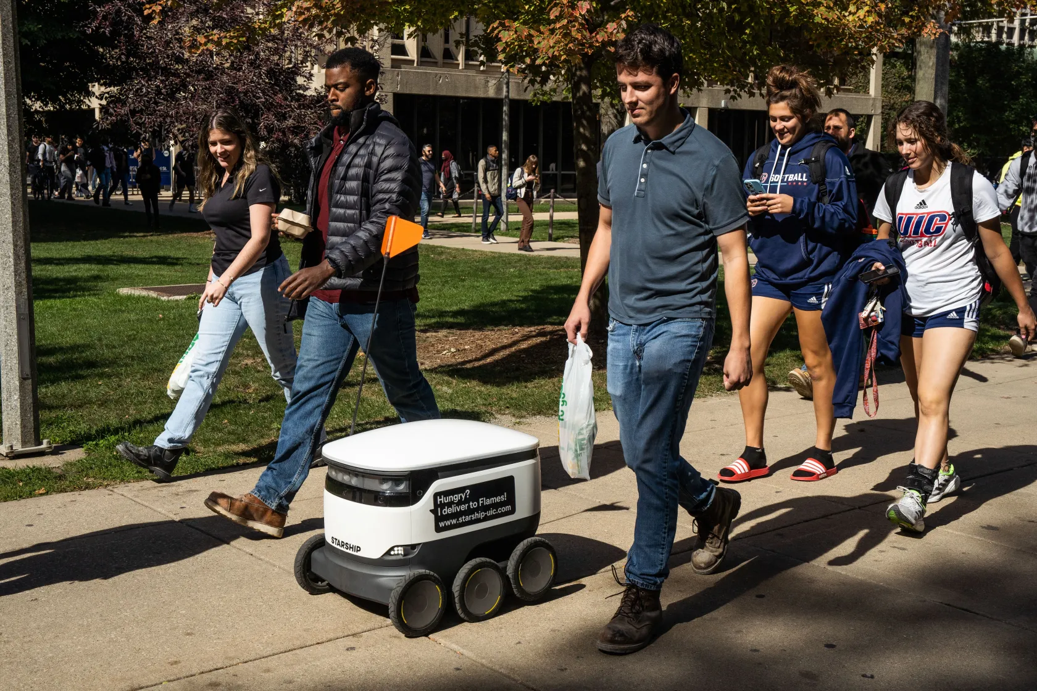
Physical Interaction between humans and social robots
Sharing an environment between humans and robots with/without a common task
A big challenge for robots living with humans is:
Figuring out what humans are up to.
How to integrate seamlessly
And what are the social norms to be followed
Image source: https://chicago.suntimes.com/2022/10/20/23390842/robot-food-delivery-uic-university-illinois-chicago-starship-doordash-grubhub-ubereats
Notes:
In the context of social robot navigation, there’s a physical interaction between humans and robots with or without a common task.
A big challenge for robots working with humans is … and what are the social norms to be followed

Slide 4
Problem Overview

Slide 5
We want to focus on robot crowd navigation
Consider the example on the right.
Robot highlighted in yellow circle
The goal is reach the yellow triangle
Ideally, we want the robot not to collide with the pedestrian
We can not treat the agents’ motion as independent since our actions influence other agents’ trajectories.
Assumption: other agents are collaborative, or at least not adversarial
Notes:
Let’s discuss the specific problem that we want to focus, which is robot crowd navigation

Slide 6
Total number of connections
Drop in the total number of connections will lead to better computational performance
n x (n - 1) x 2 x T
Spatial Dimension
Time horizon
Notes:
Current work plans robot motion on individual-to-individual basis leading to increasing dimensionality. In such setting, algorithms scales exponentially with the number of people, making the algorithms intractable for highly dense crowds.

Slide 7
Will knowledge of structured dynamics help in dealing with more dense and diverse crowds?
Notes:
In this project we want to investigate the following question: Will knowledge of structured dynamics help in dealing with more dense and diverse crowds?

Slide 8
Problem Formulation

Slide 9
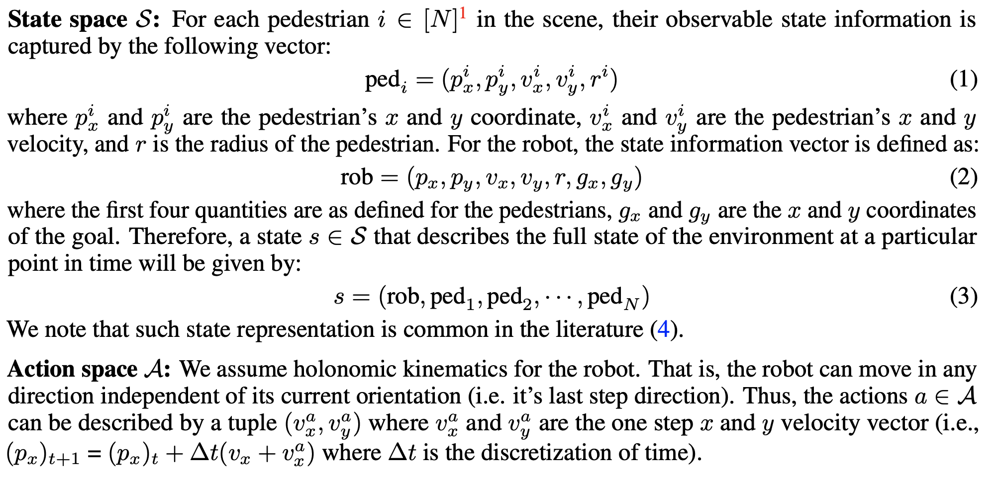
State and Action Spaces
Notes:
Now let’s talk about the formulation of our environment. We follow a typical formulation in the literature where
Each pedestrian and the robot have their position and velocity and we have a goal position. The important thing to notice is that each the state grows linearly with the number of pedestrians.
For our action space, the robot specifies a direction and a bounded distance that to move towards in a single step.

Slide 10
Reward Function
Katyal, K., Gao, Y., Markowitz, J., Pohland, S., Rivera, C., Wang, I. J., & Huang, C. M. (2022, October). Learning a group-aware policy for robot navigation. In 2022 IEEE/RSJ International Conference on Intelligent Robots and Systems (IROS) (pp. 11328-11335). IEEE.
Notes:
For our reward function, we define for separate terms. The green term reward the agent for moving towards the goal, the blue term rewards the agent for touching the goal.
The red term punishes the robot slightly for getting near pedestrians while the purple term significantly punishes colliding with pedestrians.

Slide 11
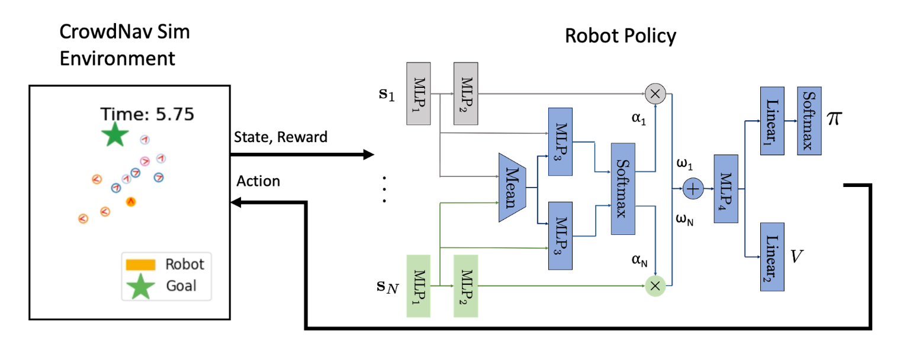
Baseline Method
Katyal, K., Gao, Y., Markowitz, J., Pohland, S., Rivera, C., Wang, I. J., & Huang, C. M. (2022, October). Learning a group-aware policy for robot navigation. In 2022 IEEE/RSJ International Conference on Intelligent Robots and Systems (IROS) (pp. 11328-11335). IEEE.
Notes:
We are measuring our performance against GroupNav which we use as our baseline method which uses attention-based actor-critic policy.
For the baseline, we are using groupnav, which is an attention based actor critic method specifically designed for the social crowd navigation environment.

Slide 12
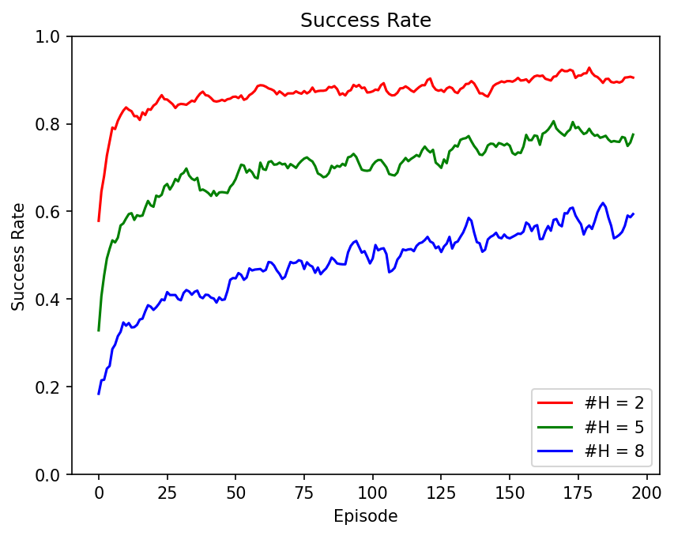
Baseline Method - Why?
Notice that increase in humans causes major reduction in success rate
Can we find a method that scales well with # of humans?
Notes:
When we evaluated the baseline on our environment, we notice that the performance significantly drops as we increase the number of human pedestrians. Note that while we do increase the number of pedestrians we ensure that they are all moving together as a single group in the same direction.

Slide 13
Methods, Modifications and Strategies
We attempted different approaches:
State Reduction
Reward Shaping
Curriculum Learning
Imitation Learning
Transformer Network
Notes:
Our goal is to find a set of modifications to the baseline that enable it to scale well as we increase the number of pedestrians in the environment.We attempted different approaches, some are listed here.

Slide 14
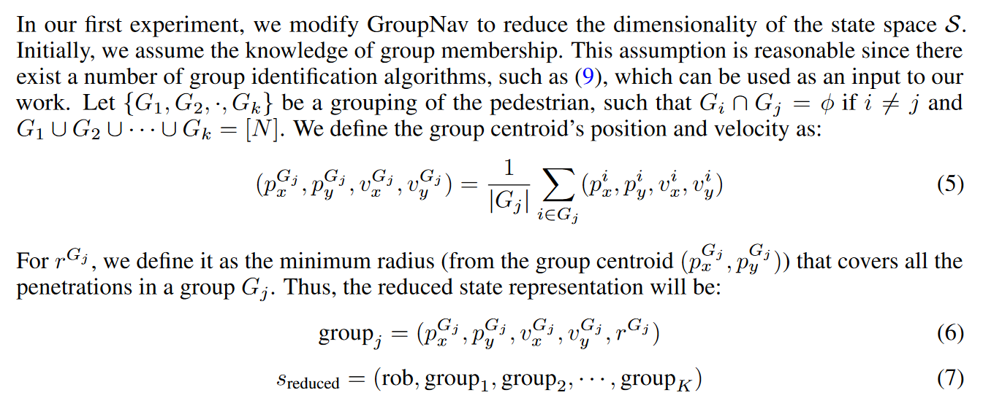
State Reduction
Notes:
The first is state reduction, where we try to mitigate the linear increase in state space by grouping multiple pedestrian into a single vector as you can see in the highlighted equation.

Slide 15
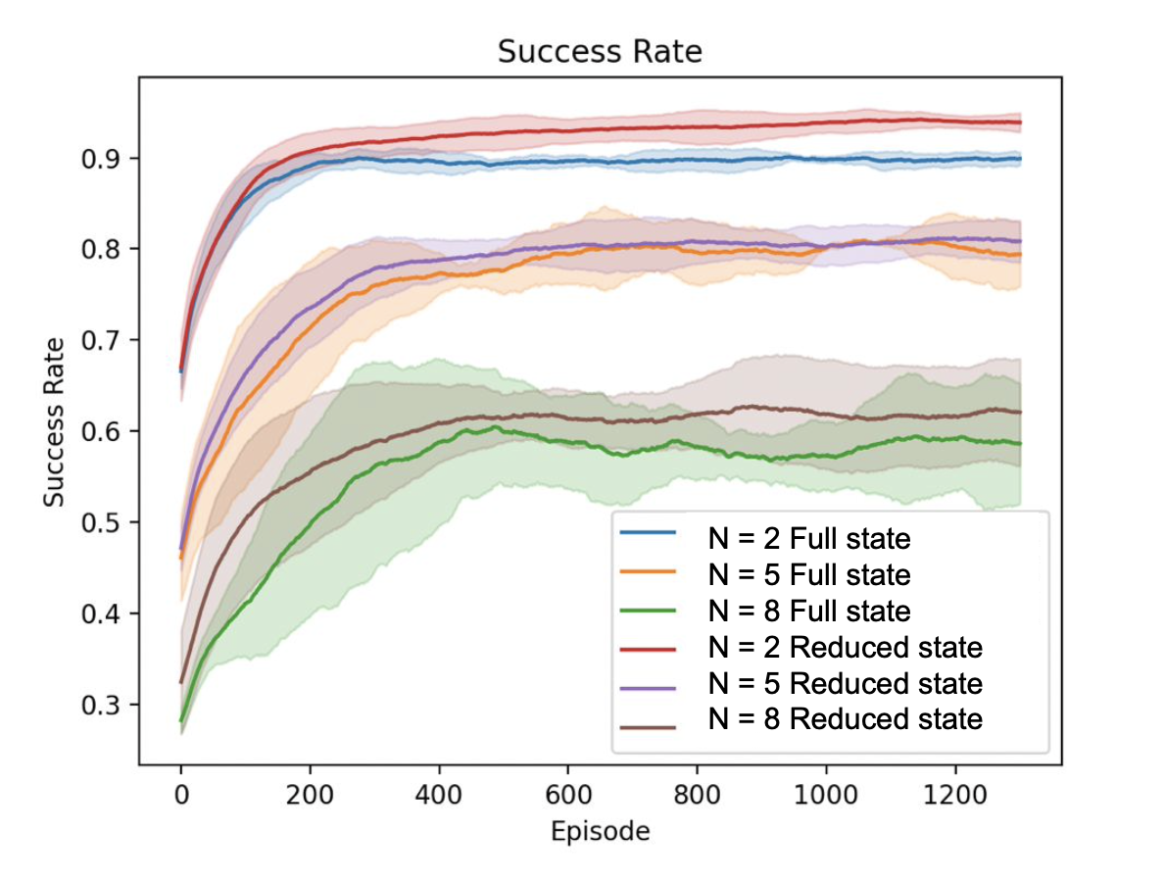
State Reduction
All pedestrians form a single group and move in the same direction
Marginal Improvement for each number of pedestrians (N)
Not enough to achieve our desired scaling
Notes:
Here we show the results of our state reduction approach. Note that all pedestrian form a single group. We notice there is a marginal improvement for different number of pedestrians (N). We conclude that state reduction is not enough to achieve our desired scaling.

Slide 16
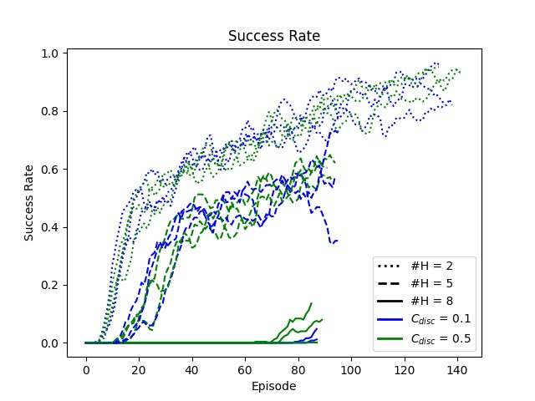
Reward Shaping (Discomfort Penalty)
This penalty is active only when the agent is close to pedestrians
We found that this term has minimal effect on performance
Notes:
One major issue we noticed is that the agent always collides with pedestrians when they are in front of the goal. To attempt to solve this issue, we tried to incentivize the agent to avoid the pedestrians path by reward shaping.
Here, we show performance versus different discomfort penalty. We have found that this term has minimal effect on performance.

Slide 17
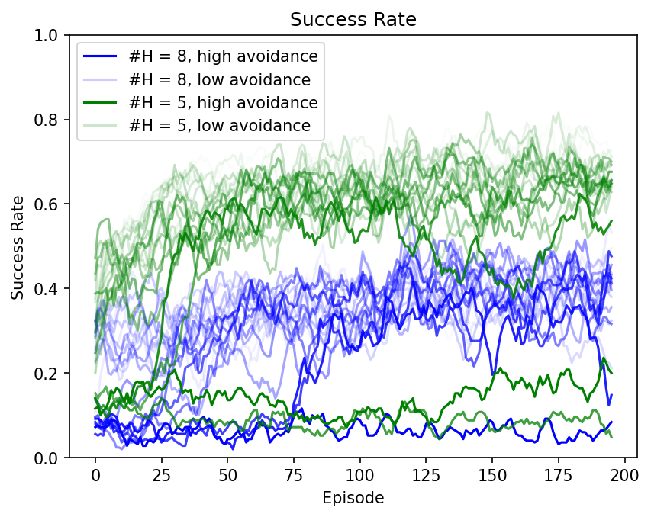
Reward Shaping (Avoidance Penalty)
Removed
This penalty is inversely proportional to the distance to pedestrians
Success rate still do not scale
Notes:
We also tried to make this term smoother by removing the indicator function highlighted in red, providing a continuous signal to the agent.
Although this term caused high variance in success rate, averaging across many models yielded marginal performance differences.

Slide 18
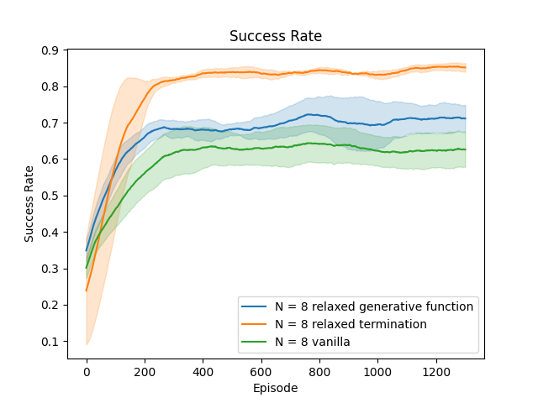
Curriculum Learning
Made a simpler/relaxed environment to make training easier
Model learns on the simpler environment then transfers to the more difficult environment
Notes:
From our previous experiments, we notice that the models seem to always prefer walking in a straight line towards the goal without avoiding pedestrians causing a collision and a termination.
Thus, we develop a modified environment that is considerably easier and less punishing to the agent by relaxing some termination conditions.
The agent was able to learn improved path-finding behaviour from the simplified environment which transferred positively to the vanilla environment.

Slide 19
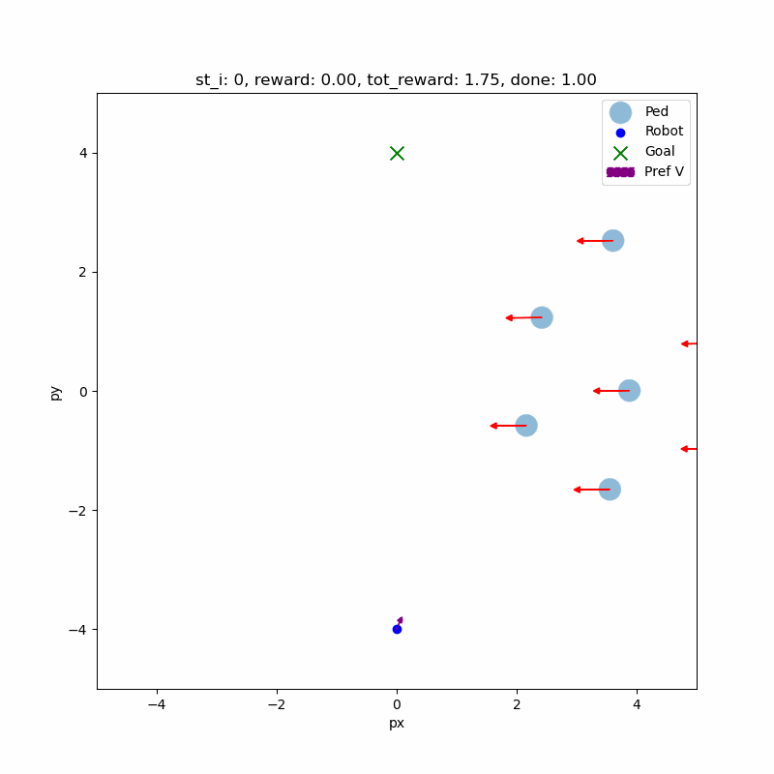
Curriculum Learning - Human Like Behavior
The agent with curriculum learning achieve around 70% success rate on the original env
Baseline performance was around 60%
The agent successfully anticipated the pedestrian’s path and preemptively avoided it
Notes:
Here we show some examples of the curriculum learning agent on the vanilla environment. In this example, we can see that the agent achieves human like behaviour by successfully anticipated the pedestrian’s path and preemptively avoiding it.

Slide 20
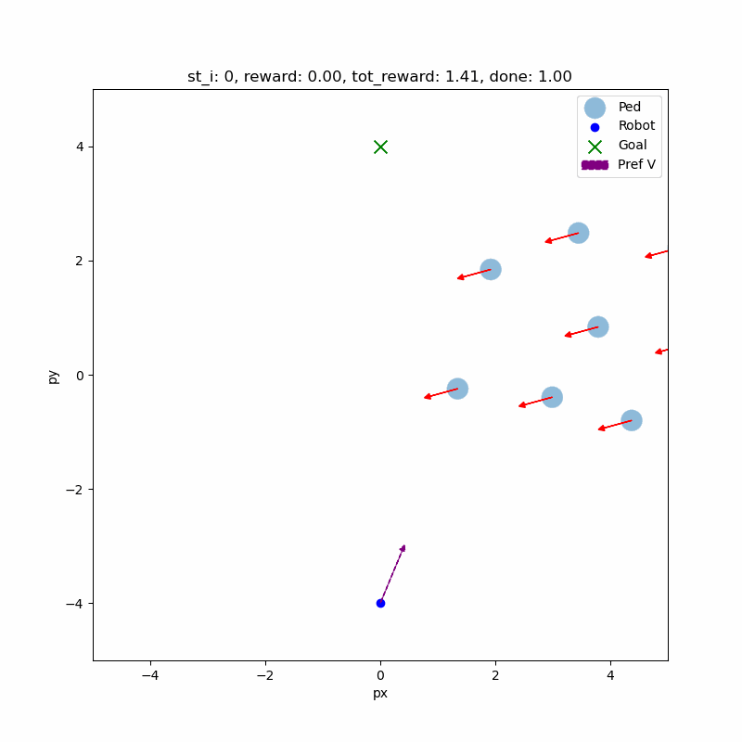
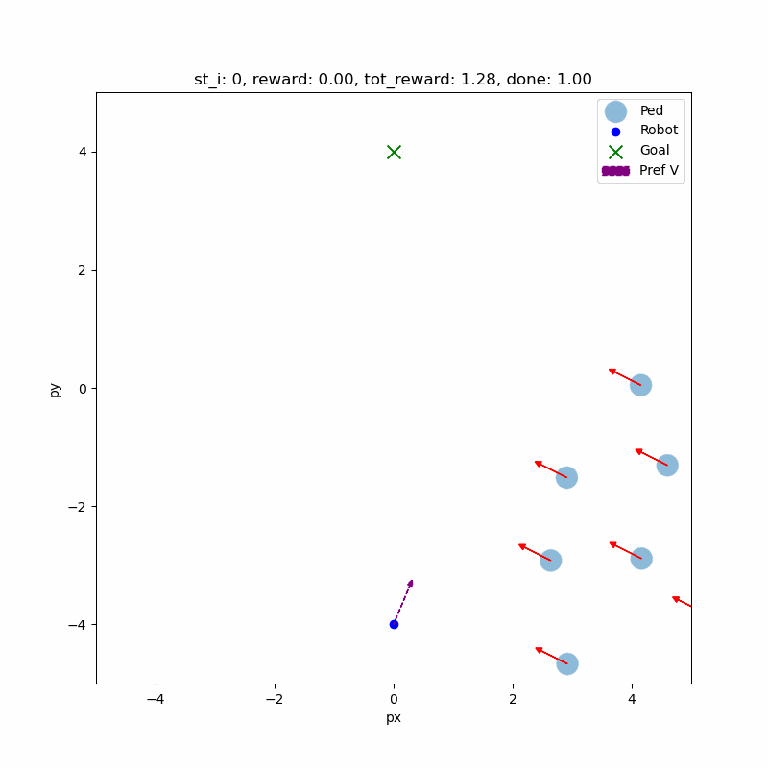
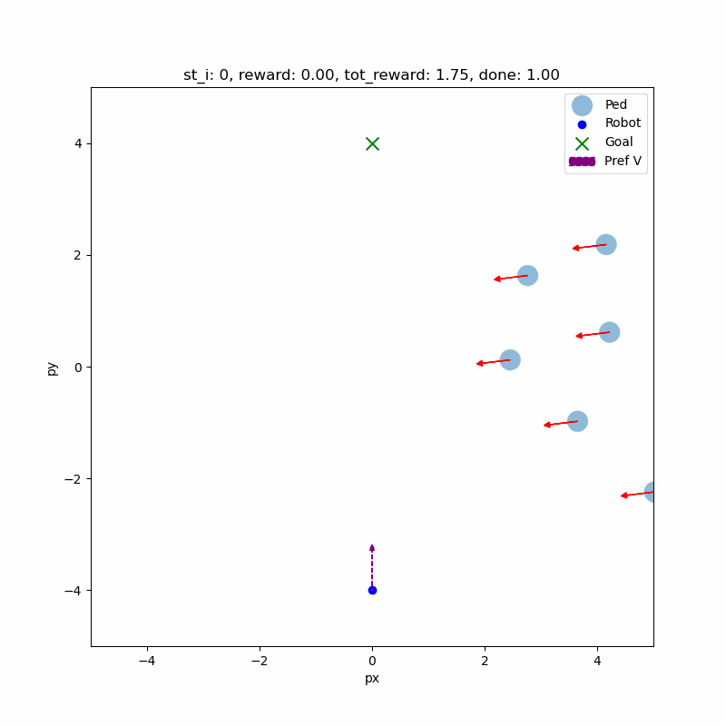
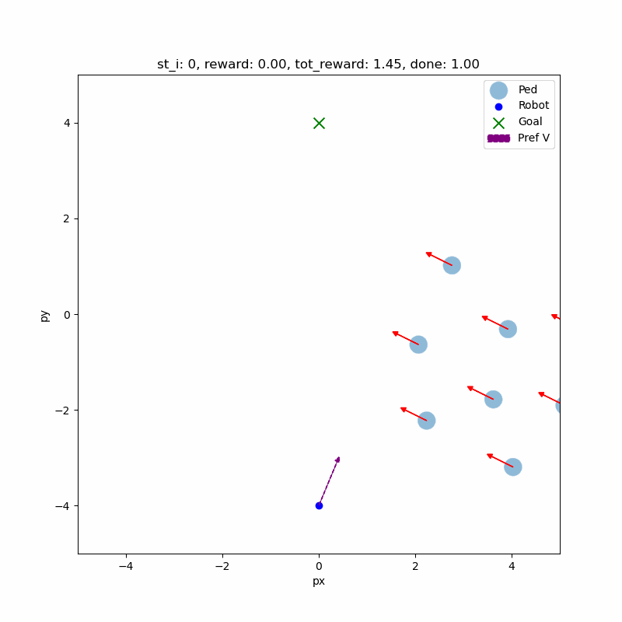
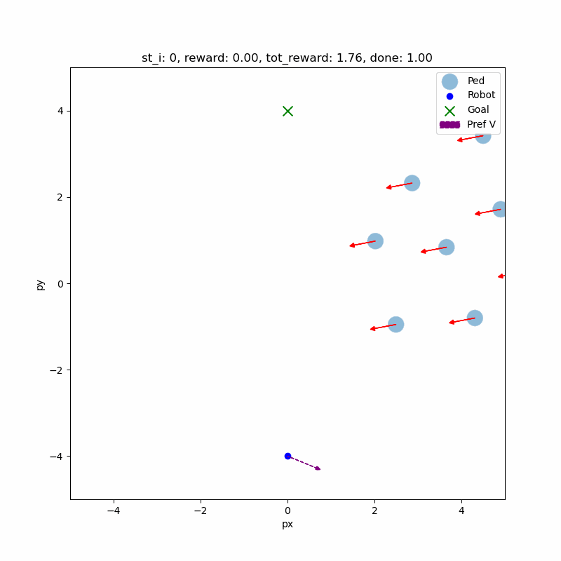
Notes:
Here we show more results. The agent immediately move behind the group and follow a very optimal path.
Here we show the results of our trained agent. We can see that it has a human like behavior by trying to go behind the group without exhibits freezing behavior.

Slide 21
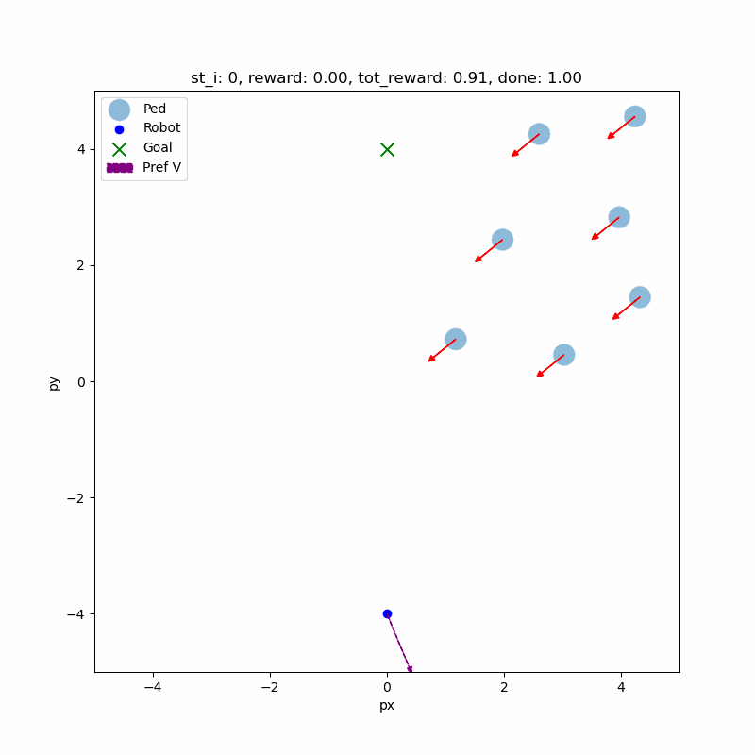
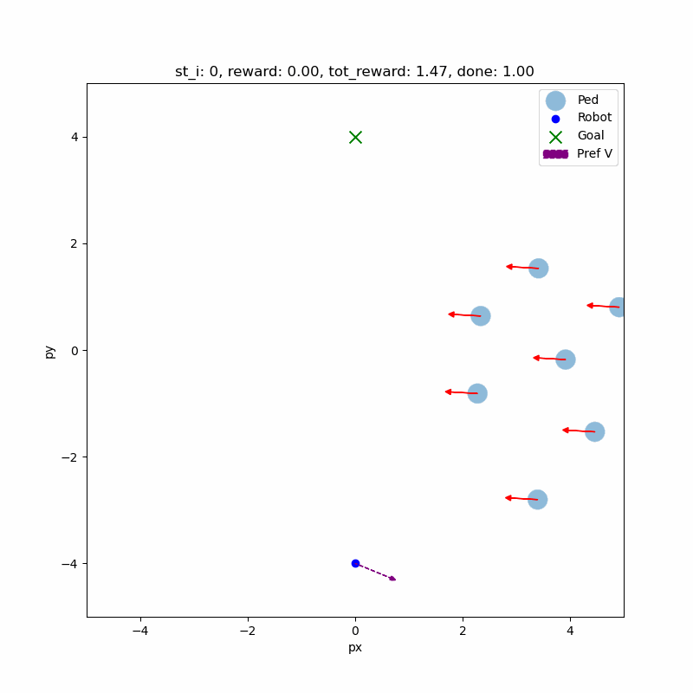
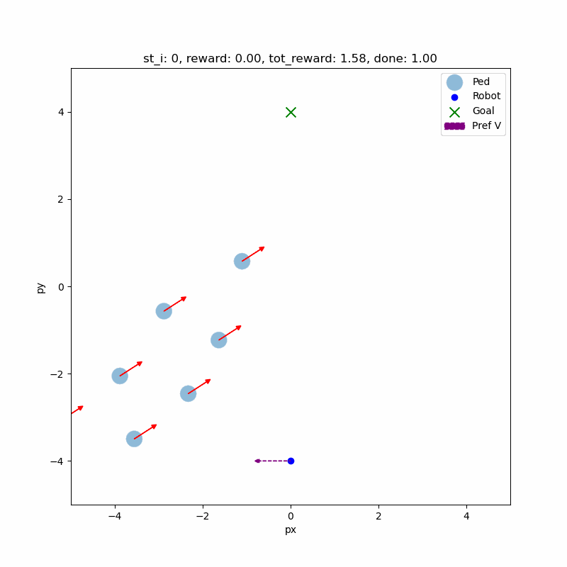
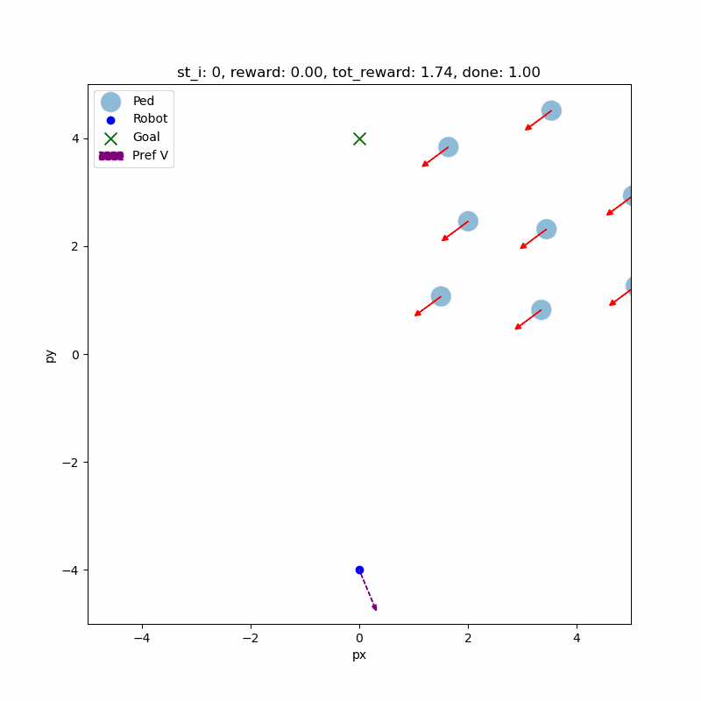
Curriculum Learning - Suboptimal Behavior
The agent waits until the pedestrians clear a simple path to the goal.
We consider this behavior to be suboptimal since it exhibits freezing behavior
Notes:
Now we show suboptimal examples, where the agent freezes and stutters while waiting for the pedestrians to clear a simple path to the goal.

Slide 22
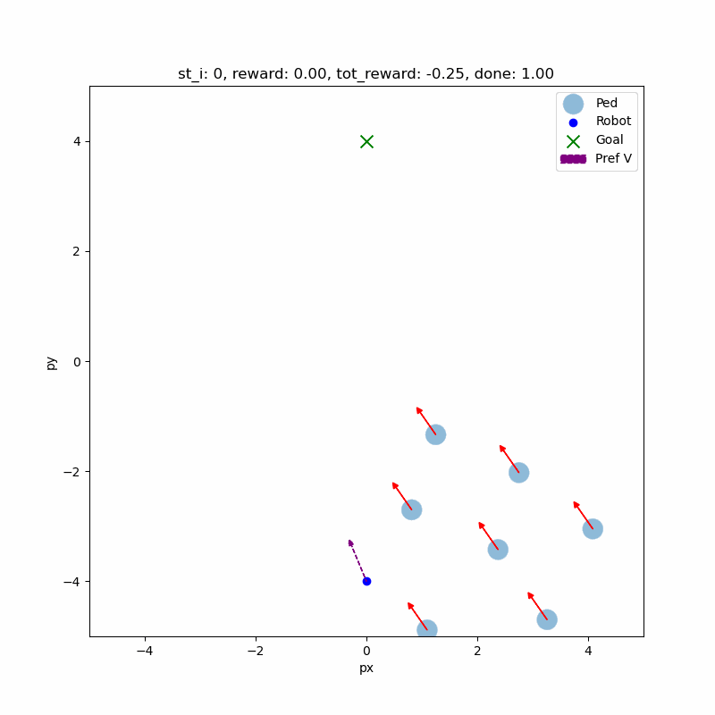
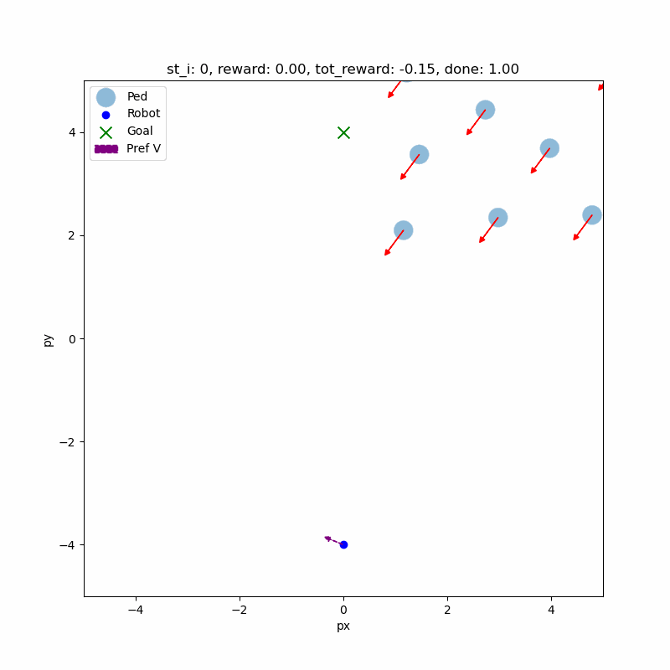
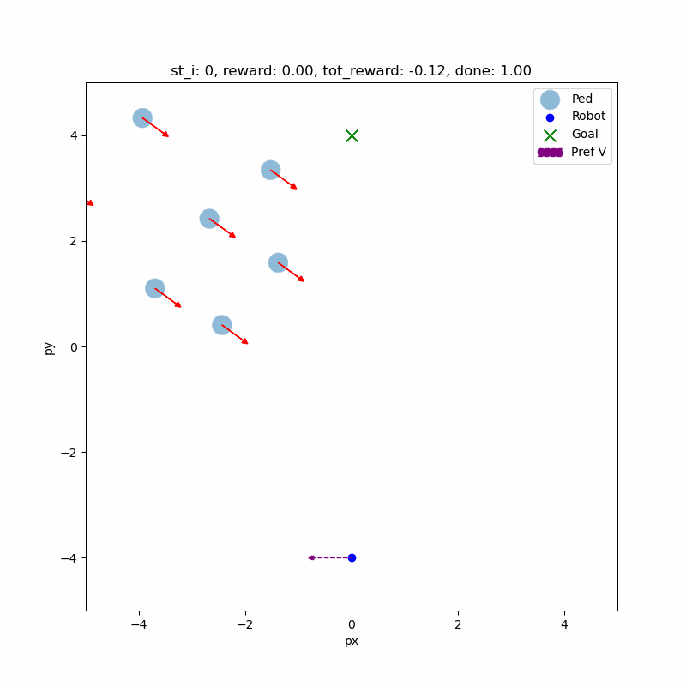
Curriculum Learning - Failures
Environment
Agent
Agent
Notes:
Finally, we noticed two modes of failures. In the first, the environment generates broken scenarios which result in instant termination.
In the second mode, the agent does not anticipate the pedestrians’ path and collides with them.
Here we highlight failures due to the environment where it generates broken scenarios which result in instant termination

Slide 23
Conclusions
Notes:
To conclude,

Slide 24
Conclusions
Investigated the role of different methodologies attempting to improve the scaling behavior we observed as we increase the number of human pedestrians
State reduction offer slight improvements to the problem;
The original environment is too difficult for models to learn from;
Curriculum Learning gave the models a suboptimal policy to start with that helped the models escape the local optimum of walking in a straight line

Slide 25
Thank you!
Notes:
Thank you

Slide 26
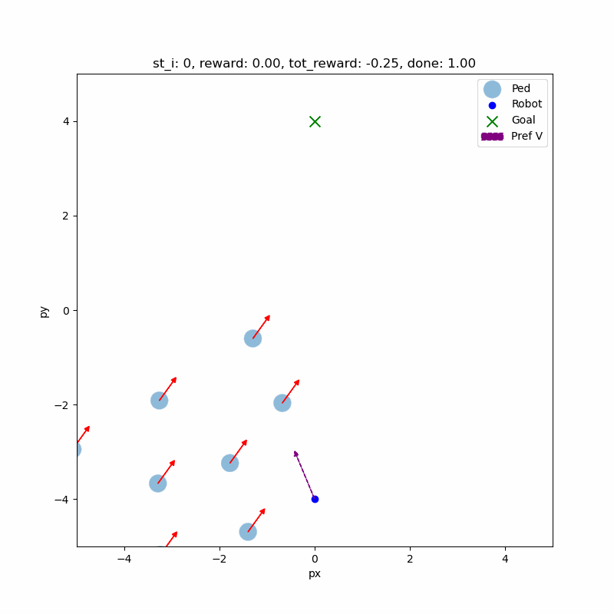
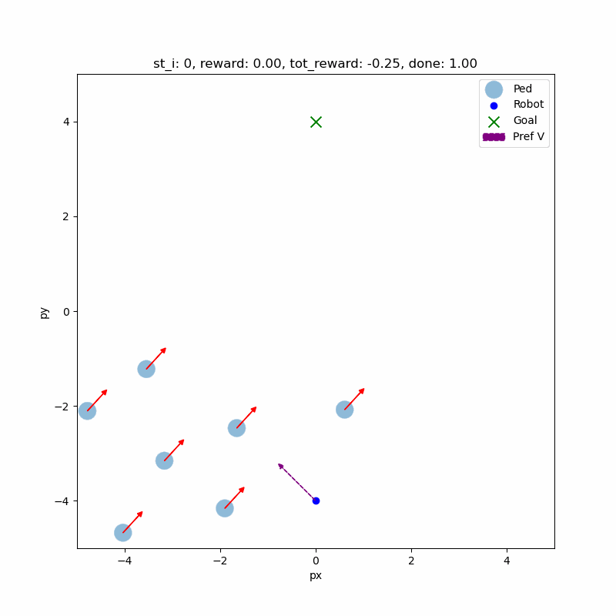
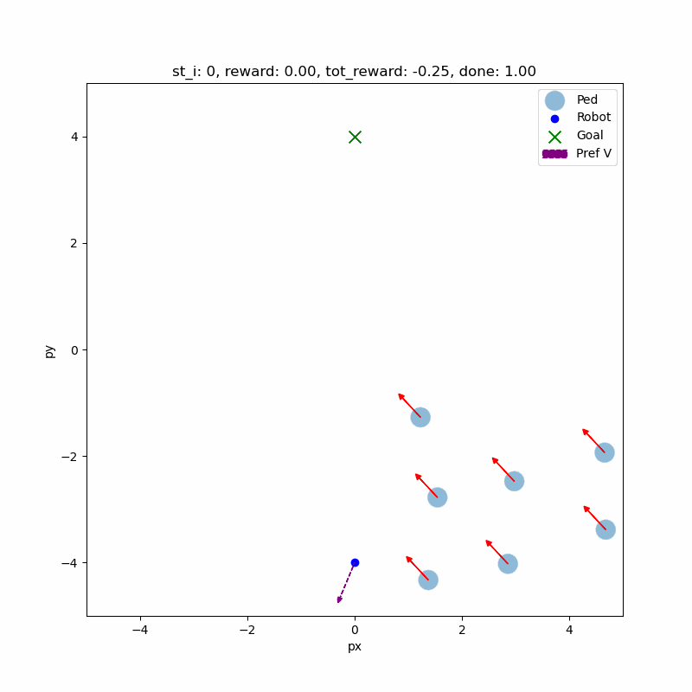
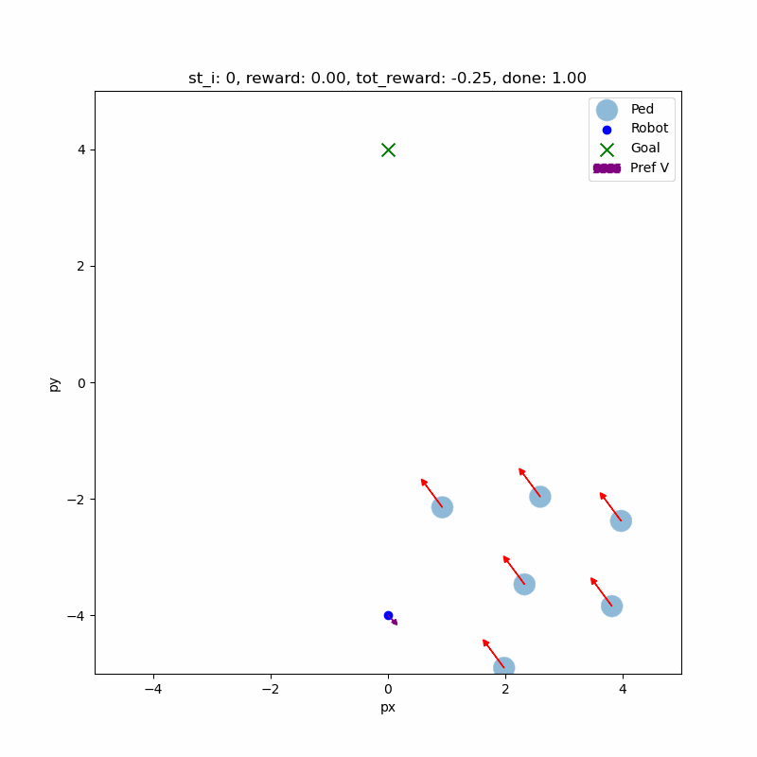
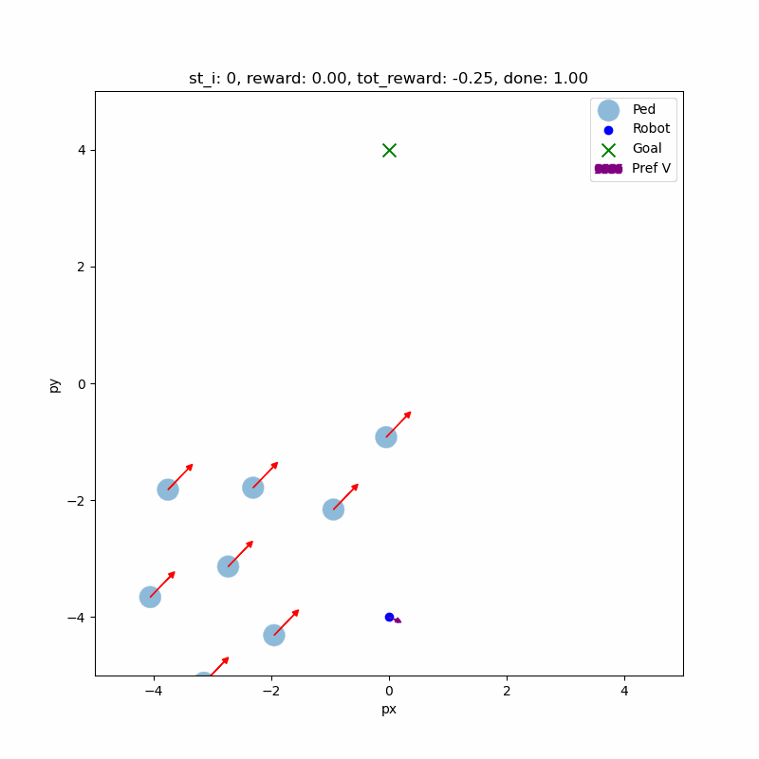
Notes:
Here are some additional example

Slide 27
Curriculum Learning - Failure Due to Agent
The agent does not anticipate the pedestrians' path and collides with them.
Notes:
Here we highlight failures due to the agent not anticipate the pedestrians’ path and collides with them

Slide 28
Curriculum Learning - Failures
Environment Faliures
Agent Faliures
The environment generates 'broken' scenarios where the agent immediately collides with pedestrians
Environments generate in a termination state
Notes:
Finally, we noticed two modes of failures.
Here we highlight failures due to the environment where it generates broken scenarios which result in instant termination

Slide 29
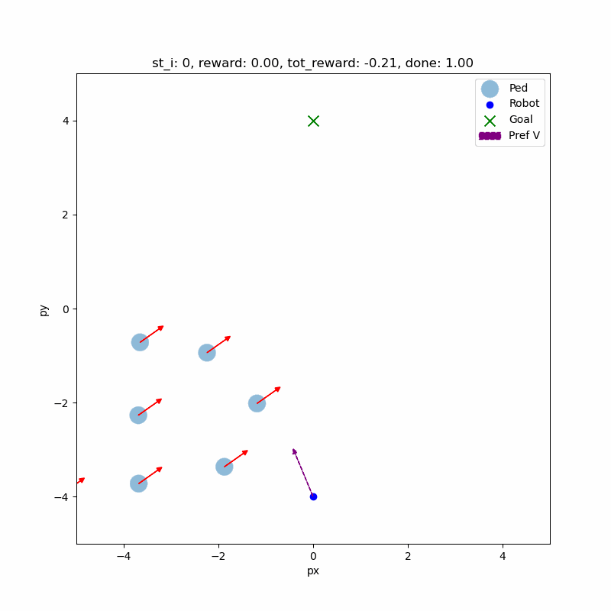
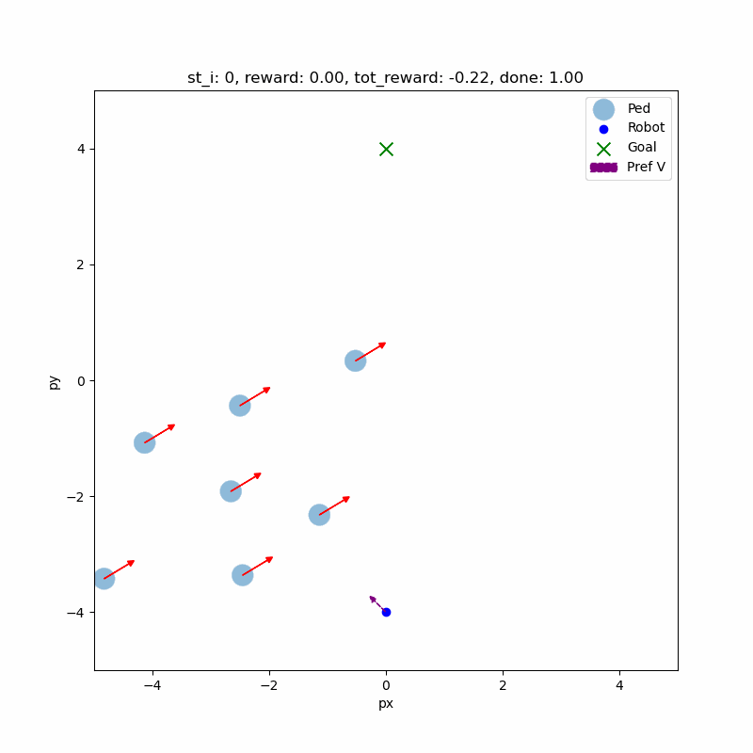
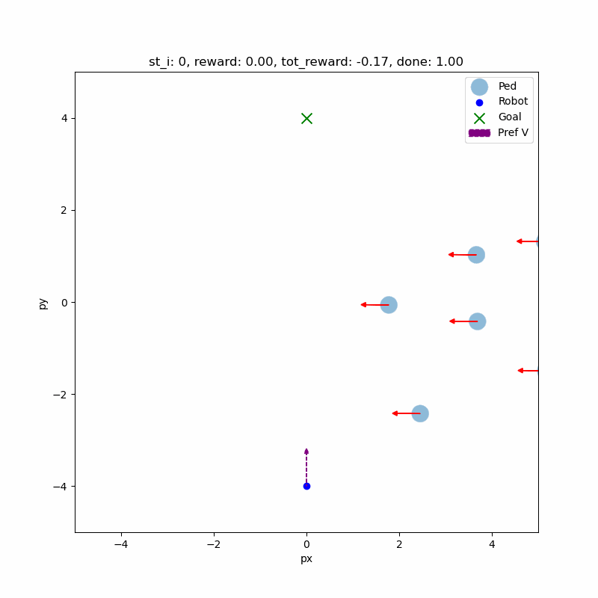
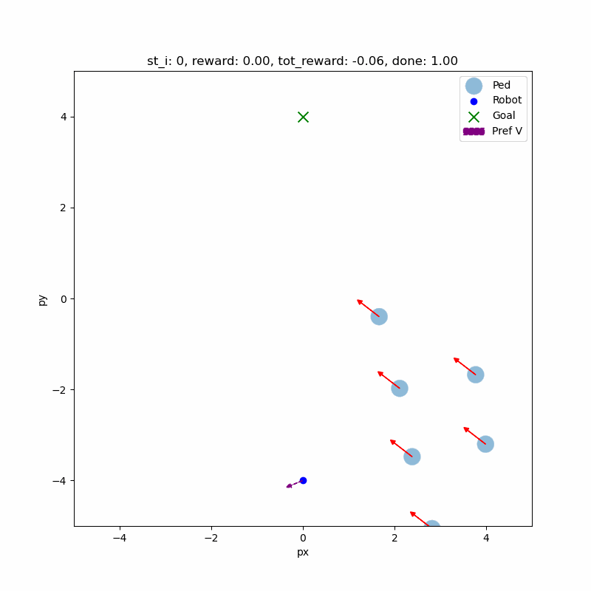
Notes:
Here we show more examples

Slide 30
Goal
Agent
Notes:
In this project we want to investigate the following question: Will knowledge of structured dynamics help in dealing with more dense and diverse crowds?

