Slide 1
Markov Chain Monte Carlo
By: Abdulrahman Alabdulkareem

Slide 2
Recap
Goals:
Problem 1: generate {x^{(r)}}^{R}_{r=1} from a target distribution P(⋅)
Problem 2: estimate expectation of function f(x) under a target distribution P(⋅). ∫P(x)f(x)dx
Requirements:
For any x, We can evaluate P*(x) within a multiplicative constant. P(x)=P*(x)/Z
In bayesian inference: L(data | parameters)*prior(parameters) is P*(x)
Solutions (from last time):
Importance Sampling: 1: x^{(r)}~Q(⋅) 2: w^{(r)}=P*(x^{(r)})/Q*(x^{(r)}) 3: ∫P(x)f(x)dx ≈ Σw^{(r)}f(x^{(r)})/Σw^{(r)}
Q needs to have heavy tails
In high dimensions: Need many samples x~Q until a sample is in a typical set of P
In high dimensions: few samples will have large weights and dominate the ratio
Rejection Sampling: 1: x^{(r)}~Q(⋅) 2: keep sample if U(0, cQ*(x^{(r)})) < P*(x^{(r)})
In high dimensions: Finding c & Q is hard and c will be extremely large.
In high dimensions: Even if Q is extremely close to P most samples will be rejected

Slide 3
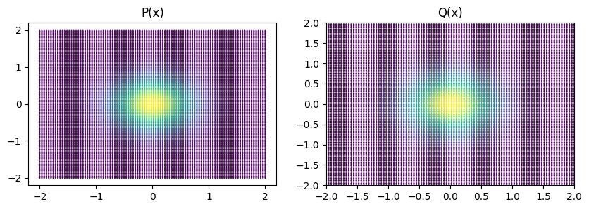
Motivating Example
P(x) = N(0_{D}, Σ_{DxD}), where Σ=0.49*I_{D}
D dimensions
Q(x) = N(0_{D}, Σ_{DxD}), where Σ=0.5*I_{D}
D dimensions
Use rejection sampling to sample from P using Q as proposal
Plots for D=2

Slide 4
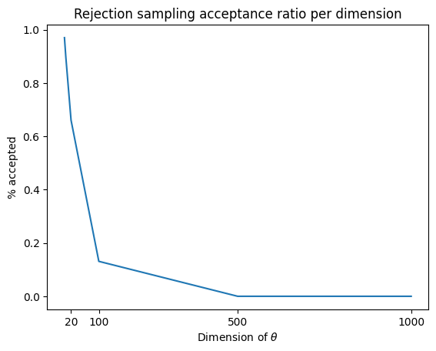
Motivating Example
Notes:
Ask for about what we expect

Slide 5
Motivating Example
Notes:
Ask for equation of decay

Slide 6
Motivating Example
1 in 16,000
@5 seconds /sample

Slide 7
Motivating Example
1 in 16,000
@5 seconds /sample
1 in 100,000
~minute /sample

Slide 8
Motivating Example
We need something better
1 in 16,000
@5 seconds /sample
1 in 100,000
~minute /sample

Slide 9
Notation
Posterior / Target distribution: P(⋅) [in text: P(⋅) and π(⋅)]
Bayesian inference notation:
Data: y [in text: x but that’s confusing]
Model Parameters: θ
Model Likelihood: L(y|θ)
Model Prior: p(θ)
Evidence(😢): Z = ∫L(y|θ)*p(θ)dθ [in text: Z or sometimes c]
Model Posterior P(⋅) = P(θ|y) = L(y|θ)*p(θ) / Z
Unnormalized Posterior P*(⋅) := Z*P(⋅) = L(y|θ)*p(θ)
Draws from Markov Chain: x^{(t)}
Proposal Distribution: Q( ⋅ ; ⋅ )
Notes:
Everything we can calculate and sample except Z and P

Slide 10
MCMC (3 simple steps)
Make a Markov Chain s.t. P(⋅) is it’s stationary distribution
Markov Chain: Sequence x⁽¹⁾,x⁽²⁾,... that satisfy the Markov property
Pr(x^{(t)} | x^{(t-1)},...,x⁽¹⁾) = Pr(x^{(t)} | x^{(t-1)}) := T(x^{(t)} ; x^{(t-1)})
The r.v. x^{(t)} only depends on x^{(t-1)} and nothing else from the past
Infinite ways to setup a Markov Chain s.t. P is it’s stationary distribution
One way: Detailed Balance Condition (also called Reversibility)
P(x^{(a)}) T(x^{(b)} ; x^{(a)}) = P(x^{(b)}) T(x^{(a)} ; x^{(b)})
Sample from chain until it reaches equilibrium… [remove burn-in samples]
Further samples from chain are dependent i.d. samples from P(⋅)

Slide 11
Metropolis-Hastings
MH is an example of an MCMC method.
Want to define T(x^{(t+1)} ; x^{(t)}) such that P(x^{(a)}) T(x^{(b)} ; x^{(a)}) = P(x^{(b)}) T(x^{(a)} ; x^{(b)})
Define T(x^{(t+1)} ; x^{(t)}) to be samples from x`~Q( ⋅ ; ⋅ ) with accept/reject

Slide 12
Metropolis-Hastings
MH is an example of an MCMC method.
Want to define T(x^{(t+1)} ; x^{(t)}) such that P(x^{(a)}) T(x^{(b)} ; x^{(a)}) = P(x^{(b)}) T(x^{(a)} ; x^{(b)})
Define T(x^{(t+1)} ; x^{(t)}) to be samples from x`~Q( ⋅ ; ⋅ ) with accept/reject
Probability of acceptance
This combination of proposal and acceptance criteria fulfils detailed balance
What are the user-defined parts of this algorithm? [ To achieve P(⋅) ]
Proposal distribution Q( ⋅ ; ⋅ )
Initial starting position x⁰

Slide 13
Metropolis-Hastings Algorithm
Start at x⁽⁰⁾
For t = 0,1,2,... (infinitely)
x’~ Q(x;x^{(t)}) #temporary variable
S #acceptance probability
If rand() < a:
x^{(t+1)} = x’ #temp variable becomes our next sample
else
x^{(t+1)} = x^{(t)} #even when rejecting we still get samples

Slide 14
Metropolis-Hastings Algorithm
Start at x⁽⁰⁾
For t = 0,1,2,... (infinitely)
x’~ Q(x;x^{(t)}) #temporary variable
#if Q is symmetric w.r.t. conditional
If rand() < a:
x^{(t+1)} = x’ #temp variable becomes our next sample
else
x^{(t+1)} = x^{(t)} #even when rejecting we still get samples

Slide 15
Justification for MH
We needed T(x^{(t+1)} ; x^{(t)}) to fulfill P(x^{(t)}) T(x^{(t+1)} ; x^{(t)}) = P(x^{(t+1)}) T(x^{(t)} ; x^{(t+1)})
T(x^{(t+1)} ; x^{(t)}) = Q(x^{(t+1)} ; x^{(t)})*a(x^{(t+1)} ; x^{(t)}) ???

Slide 16
Justification for MH
We needed T(x^{(t+1)} ; x^{(t)}) to fulfill P(x^{(t)}) T(x^{(t+1)} ; x^{(t)}) = P(x^{(t+1)}) T(x^{(t)} ; x^{(t+1)})
T(x^{(t+1)} ; x^{(t)}) = Q(x^{(t+1)} ; x^{(t)})*a(x^{(t+1)} ; x^{(t)}) + P(reject from x^{(t)})*δ_{xt}(x^{(t+1)})
P(reject from x^{(t)}) = 1 - ∫ Q(s ; x^{(t)})*a(s ; x^{(t)}) ds
Does T(x^{(t+1)} ; x^{(t)}) fulfil detailed balance ??
For x^{(t+1)} ≠ x^{(t)} then:

Slide 17
Justification for MH
We needed T(x^{(t+1)} ; x^{(t)}) to fulfill P(x^{(t)}) T(x^{(t+1)} ; x^{(t)}) = P(x^{(t+1)}) T(x^{(t)} ; x^{(t+1)})
T(x^{(t+1)} ; x^{(t)}) = Q(x^{(t+1)} ; x^{(t)})*a(x^{(t+1)} ; x^{(t)}) + P(reject from x^{(t)})*δ_{xt}(x^{(t+1)})
P(reject from x^{(t)}) = 1 - ∫ Q(s ; x^{(t)})*a(s ; x^{(t)}) ds
Does T(x^{(t+1)} ; x^{(t)}) fulfil detailed balance ??
For x^{(t+1)} ≠ x^{(t)} then:
Thus detailed balance is fulfilled

Slide 18
Clearing up confusion in Q
Proposal density Q(⋅) (so many ‘Q’ distributions)
VI: We optimize distribution q*
Rejection sampling: sample from simple proposal Q
Must strictly cover P* ( cQ*(x)>P*(x) ) and be similar to P(⋅), otherwise very bad
Metropolis Hastings: sample x^{(t+1)} from simple proposal Q dependant on x^{(t)}
Should cover all space[*]
Not need for Q(x;x^{(t)}) to look anything like P*(⋅)
Sometimes just a gaussian with mean x^{(t)} (but what variance??)

Slide 19
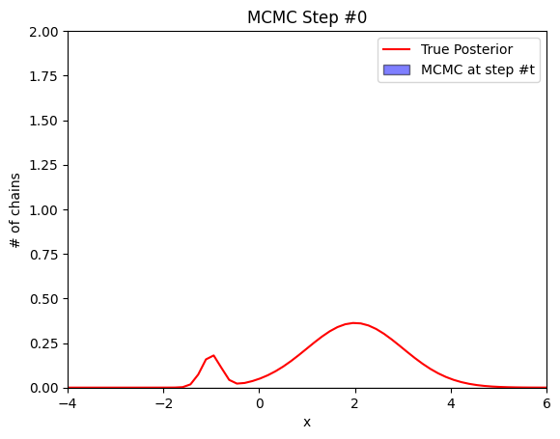
MH in action

Slide 20
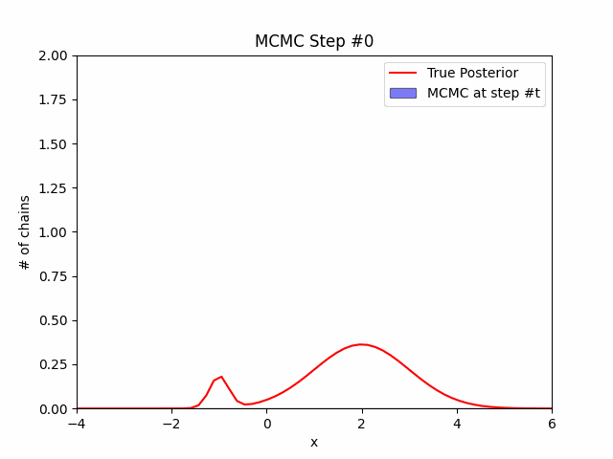
MH simple example

Slide 21
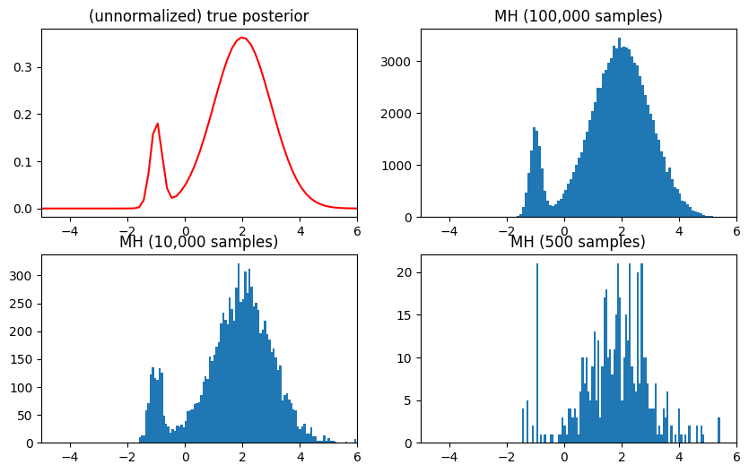
MH simple example

Slide 22
Problems with Modalities and Initial position

Slide 23
Problems with Modalities and Initial position

Slide 24
Distribution of burn-in samples
x⁽⁰⁾
T(x;x⁽⁰⁾)
x⁽¹⁾
T(x;x⁽¹⁾)
x⁽²⁾
T(x;x⁽²⁾)
x⁽³⁾
…
x^{(N)}

Slide 25
Distribution of burn-in samples
x⁽⁰⁾
T(x;x⁽⁰⁾)
x⁽¹⁾
T(x;x⁽¹⁾)
x⁽²⁾
T(x;x⁽²⁾)
x⁽³⁾
…
x^{(N)}
What is the distribution of X⁽¹⁾??

Slide 26
Distribution of burn-in samples
Keep x⁽⁰⁾ fixed
x⁽⁰⁾
T(x;x⁽⁰⁾)
x⁽¹⁾
T(x;x⁽¹⁾)
x⁽²⁾
T(x;x⁽²⁾)
x⁽³⁾
…
x^{(N)}
T(x;x⁽⁰⁾)
T(x;x`⁽¹⁾)
T(x;x`⁽²⁾)
…
x⁽⁰⁾
x`⁽¹⁾
x`⁽²⁾
x`⁽³⁾
x`^{(N)}
Repeat many times…
x⁽⁰⁾
T(x;x⁽⁰⁾)
T(x;x`⁽¹⁾)
T(x;x`⁽²⁾)
…
x`⁽¹⁾
x`⁽²⁾
x`⁽³⁾
x`^{(N)}

Slide 27
Distribution of burn-in samples
Keep x⁽⁰⁾ fixed
x⁽⁰⁾
T(x;x⁽⁰⁾)
x⁽¹⁾
T(x;x⁽¹⁾)
x⁽²⁾
T(x;x⁽²⁾)
x⁽³⁾
…
x^{(N)}
T(x;x⁽⁰⁾)
T(x;x`⁽¹⁾)
T(x;x`⁽²⁾)
…
x⁽⁰⁾
x`⁽¹⁾
x`⁽²⁾
x`⁽³⁾
x`^{(N)}
Repeat many times…
x⁽⁰⁾
T(x;x⁽⁰⁾)
T(x;x`⁽¹⁾)
T(x;x`⁽²⁾)
…
x`⁽¹⁾
x`⁽²⁾
x`⁽³⁾
x`^{(N)}

Slide 28
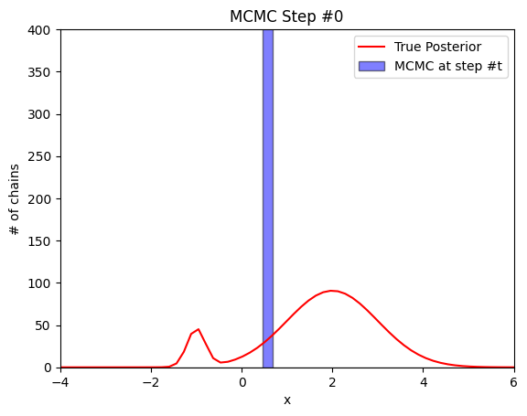
Distribution of 1,000 MCMC chains
x⁽⁰⁾ = 0.5
Q(x`;x) = N(x,σ)
where σ=0.1
Notes:
Ask why most turned left?

Slide 29
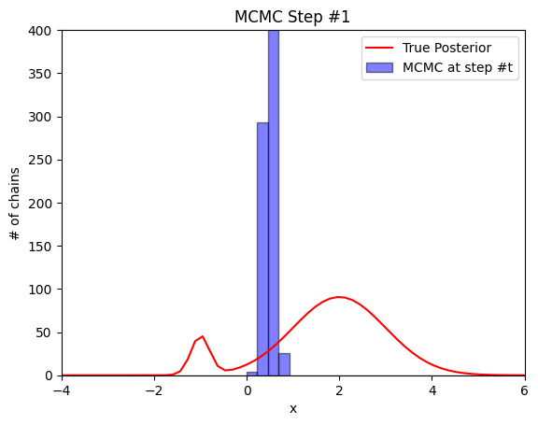
Distribution of 1,000 MCMC chains
x⁽⁰⁾ = 0.5
Q(x`;x) = N(x,σ)
where σ=0.1
Notes:
Question: LEFT?
why did most turn left?

Slide 30
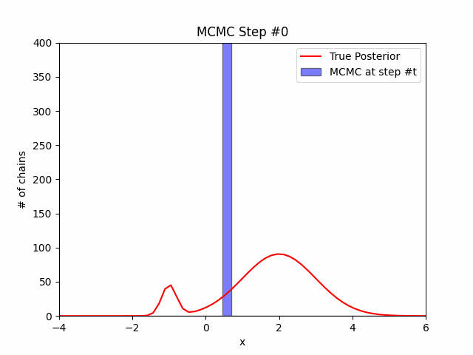
Distribution of 1,000 MCMC chains
x⁽⁰⁾ = 0.5
Q(x`;x) = N(x,σ)
where σ=0.1

Slide 31
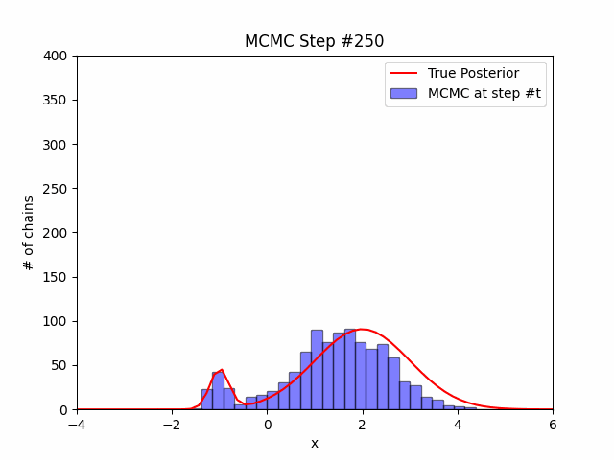
Distribution of 1,000 MCMC chains
x⁽⁰⁾ = 0.5
Q(x`;x) = N(x,σ)
where σ=0.1
Notes:
2 minutes to run

Slide 32
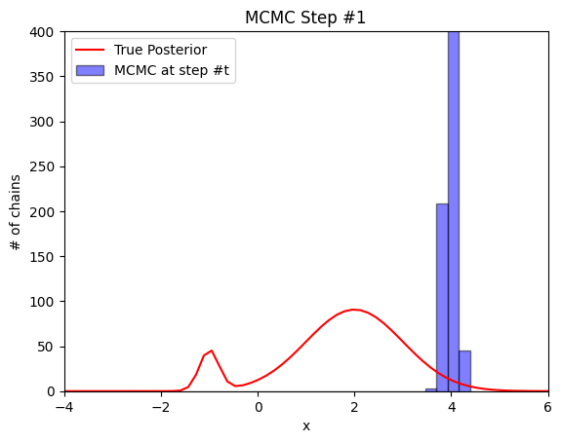
Distribution of 1,000 MCMC chains
x⁽⁰⁾ = 4
Q(x`;x) = N(x,σ)
where σ=0.1

Slide 33
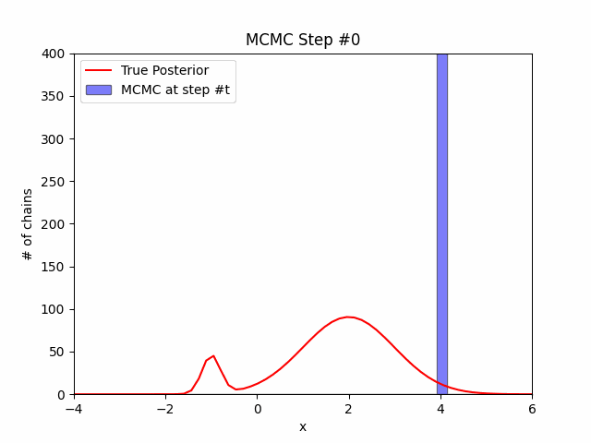
Distribution of 1,000 MCMC chains
x⁽⁰⁾ = 4
Q(x`;x) = N(x,σ)
where σ=0.1

Slide 34
Solution for slow equilibrium
Slow convergence? How about making σ larger?
Q(x`;x) = N(x,10) instead of N(x,1) ?

Slide 35
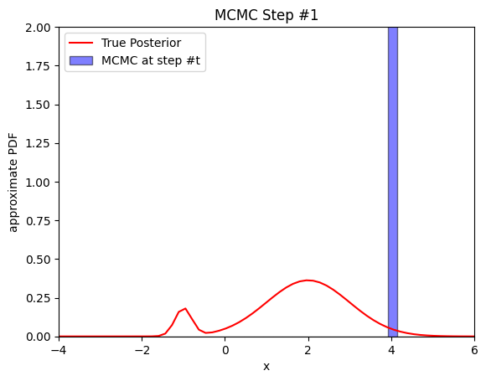
Solution for slow equilibrium
Slow convergence? How about making σ larger?
Q(x`;x) = N(x,10) instead of N(x,1) ?

Slide 36
Solution for slow equilibrium
Slow convergence? How about making σ larger?
Q(x`;x) = N(x,10) instead of N(x,1) ?

Slide 37
Surface Level Proof of MH
Part1 - Convergence: If Markov chain is irreducible and aperiodic then it converges to unique stationary distribution
Part 2 - If Chain fulfills detailed balance condition for P(⋅) then P(⋅) is the unique stationary distribution of the chain (sufficient, but not necessary condition)
detailed balance condition: P(x^{(a)}) T(x^{(b)} ; x^{(a)}) = P(x^{(b)}) T(x^{(a)} ; x^{(b)})
Where T(x^{(t+1)} ; x^{(t)}) is Q(x^{(t+1)} ; x^{(t)})*a(x^{(t+1)} ; x^{(t)})+P(reject from x^{(t)})*δ_{xt}(x^{(t+1)})
Part 3 - Our chain fulfills part 1 thus it converges to a unique distribution, and some arithmetic shows that our clever choice of the acceptance criteria fulfills the detailed balance condition for our target distribution P(⋅) [part 2]
Source (full proof): similarweb.engineering/mcmc

Slide 38
MCMC Bayesian Inference
Data analysis goal (curve-fitting with outliers)
Collection of samples (x⁽¹⁾,y⁽¹⁾),...,(x^{(N)},y^{(N)}), most samples are linear except some outliers
Want to find the best fit line (ignoring outliers) as well as the P((x^{(i)},y^{(i)}) is outlier)
Build a model (parameters: m, b, λ, ε, o^{(1:N)})
Data (for each datapoint):
Not Outlier: y^{(i)}|o^{(i)}=0,x^{(i)} ~ N(m*x^{(i)}+b, ε)
Is Outlier: y^{(i)}|o^{(i)}=1,x^{(i)} ~ N(0, 10)
Priors:
Outlier per datapoint: P(o^{(i)} = 1) = λ [bernoulli]
Slope: m ~ N(0, 2)
Intercept: b ~ N(0, 2)
Noise: ε ~ Γ(1, 1)
Outlier prob: λ ~ U(0, 1)
Source: Gen Tutorials [ gen.dev/tutorials/iterative-inference/tutorial ]

Slide 39
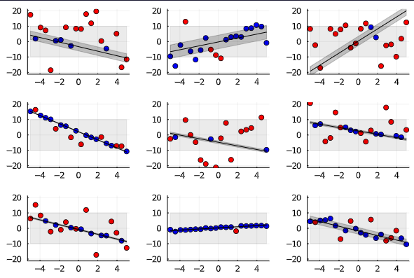
MCMC Bayesian Inference
Before we try inference on real data
Let’s try to generate synthetic data from the model
Pick 20 x’s from -5 to 5.
x⁽¹⁾=-5, x⁽²⁾=-4.5, …, x⁽²⁰⁾=5
Sample m, b, ε, λ, o⁽¹⁾,...,o⁽²⁰⁾ from prior
Sample y^{(i)}s from Likelihood
not outlier: N(m*x^{(i)}+b, ε)
Outlier: N(0, 10)
Source: Gen Tutorials [ gen.dev/tutorials/iterative-inference/tutorial ]

Slide 40
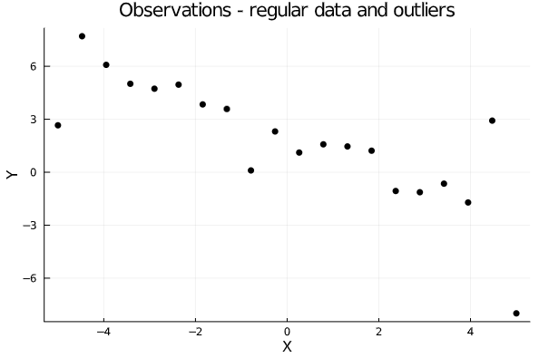
MCMC Bayesian Inference
Let’s move to real data
Fix (x⁽¹⁾,y⁽¹⁾),...,(x⁽²⁰⁾,y⁽²⁰⁾)
Want to sample from the posterior P(parameters|data)
P(m,b,ε,λ,o⁽¹⁾,...,o⁽²⁰⁾ | x⁽¹⁾,y⁽¹⁾,...,y⁽²⁰⁾)
Source: Gen Tutorials [ gen.dev/tutorials/iterative-inference/tutorial ]

Slide 41
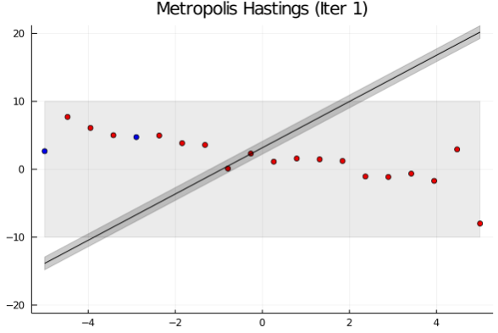
MCMC Bayesian Inference
Let’s move to real data
Fix (x⁽¹⁾,y⁽¹⁾),...,(x⁽²⁰⁾,y⁽²⁰⁾)
Want to sample from the posterior P(parameters|data)
P(m,b,ε,λ,o⁽¹⁾,...,o⁽²⁰⁾ | x⁽¹⁾,y⁽¹⁾,...,y⁽²⁰⁾)
Source: Gen Tutorials [ gen.dev/tutorials/iterative-inference/tutorial ]

Slide 42
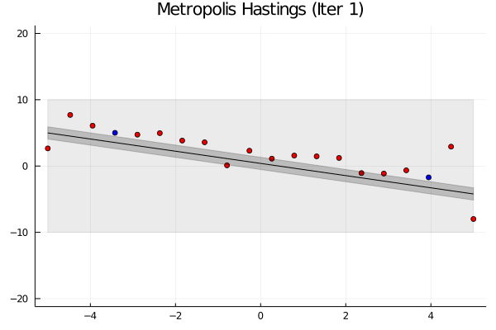
MCMC Bayesian Inference
Let’s move to real data
Fix (x⁽¹⁾,y⁽¹⁾),...,(x⁽²⁰⁾,y⁽²⁰⁾)
Want to sample from the posterior P(parameters|data)
P(m,b,ε,λ,o⁽¹⁾,...,o⁽²⁰⁾ | x⁽¹⁾,y⁽¹⁾,...,y⁽²⁰⁾)
Source: Gen Tutorials [ gen.dev/tutorials/iterative-inference/tutorial ]

Slide 43
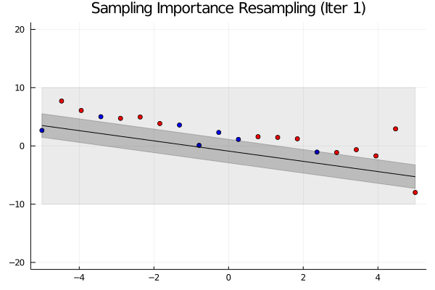
Compare with Sampling Importance Resampling
Let’s move to real data
Fix (x⁽¹⁾,y⁽¹⁾),...,(x⁽²⁰⁾,y⁽²⁰⁾)
Want to sample from the posterior P(parameters|data)
P(m,b,ε,λ,o⁽¹⁾,...,o⁽²⁰⁾ | x⁽¹⁾,y⁽¹⁾,...,y⁽²⁰⁾)
Source: Gen Tutorials [ gen.dev/tutorials/iterative-inference/tutorial ]

Slide 44
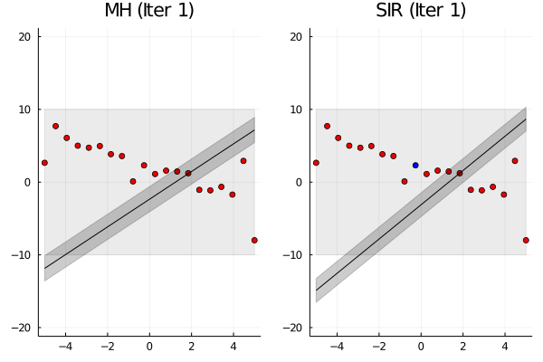
Side-by-Side
Source: Gen Tutorials [ gen.dev/tutorials/iterative-inference/tutorial ]

Slide 45
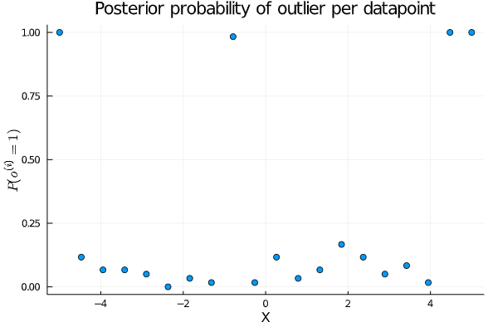
Get posterior probabilities

Slide 46
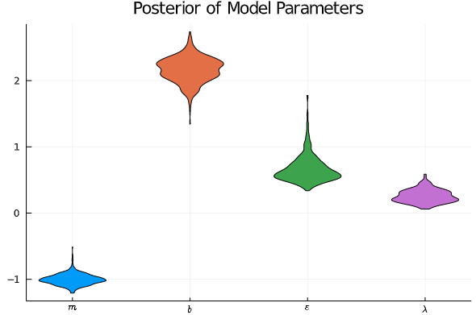
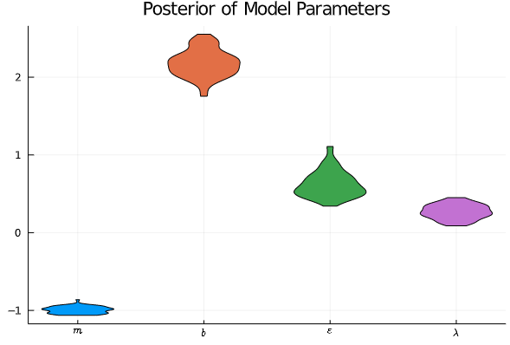
Get posterior probabilities

Slide 47
Questions

